Slide 1
Airline Customer Reviews Analysis
A Look at British Airways Customer Reviews

Slide 2
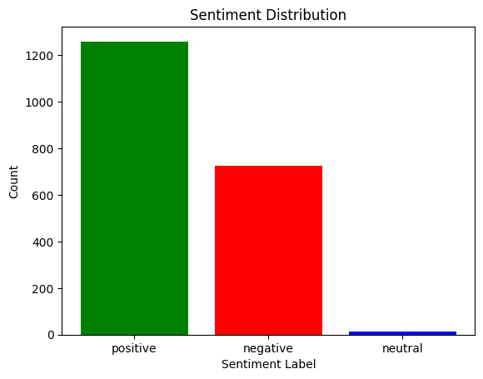

Slide 3
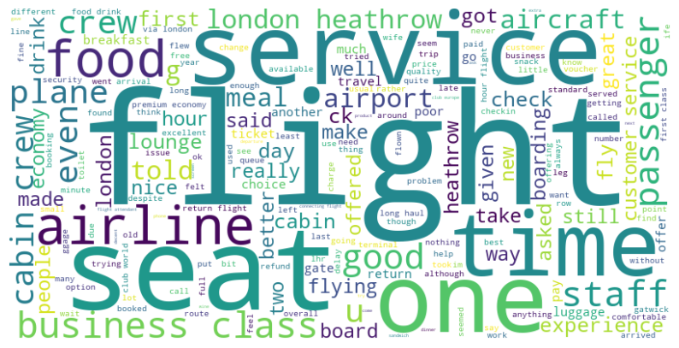
Word Cloud

